Slide 1
Final Project
Course Title:
ECE 172 Fundamentals of Machine Learning
Instructor:
Dr. Hovannes Kulhandjian
By… Puya Fard

Slide 2
Objective
The objective of this project is to develop and train a deep convolutional neural network (DCNN) architecture in Matlab using a professor approved image dataset, handwritten arabic characters. The aim is to achieve high accuracy in image classification by optimizing the learning rate and gradient descent algorithm.
The project also involves plotting the accuracy vs epochs and iterations and analyzing the confusion matrix to identify the best performing classifier.
Additionally, three pre-trained models from the Matlab Toolbox Deep Neural Designer will be trained, and their accuracy vs epoch will be plotted for comparison with the results obtained from the DCNN model.
The goal is to identify the best performing model and comment on the performance and training time of each algorithm.

Slide 3
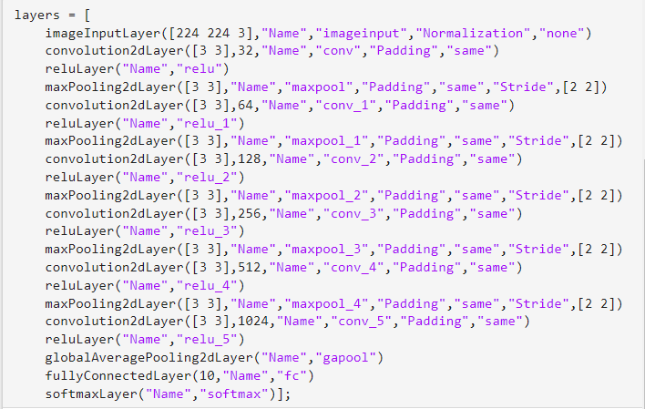
Architectures Utilized
DCNN Architecture
The architecture consists of multiple convolutional layers, each followed by a ReLU activation function and a max pooling layer. The final layers are a global average pooling layer, a fully connected layer, a softmax layer, and a classification layer.
DarkNet-19 Architecture
ResNet-50 Architecture
Efficient B0 Architecture
This is a code block that defines a convolutional neural network (CNN) in MATLAB using the Deep Learning Toolbox. The layers in this network are defined sequentially, with each layer being added to the list of layers.

Slide 4
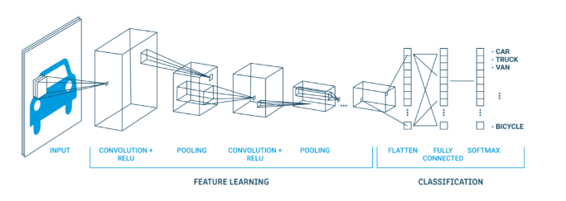
Deep Convolutional Neural Network (DCNN)
The strength of DCNNs is in their layering. A DCNN uses a three-dimensional neural network to process the Red, Green, and Blue elements of the image at the same time. This considerably reduces the number of artificial neurons required to process an image, compared to traditional feed forward neural networks.
Deep convolutional neural networks receive images as an input and use them to train a classifier. The network employs a special mathematical operation called a “convolution” instead of matrix multiplication.
The architecture of a convolutional network typically consists of four types of layers: convolution, pooling, activation, and fully connected.

Slide 5
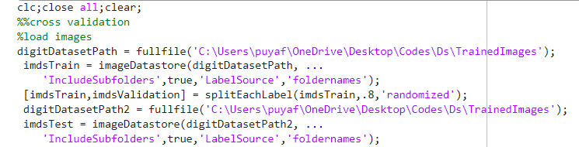
General Implementation of DCNN
Load the image data using the imageDatastore function. The data is organized into subfolders, with each subfolder containing images of a specific class.
Split the data into training and validation sets using the splitEachLabel function. In this case, 80% of the data is used for training, and 20% is used for validation.
Notes:
This code imports a dataset of images from the specified directory and creates an imageDatastore object that stores the images and their corresponding labels. The 'IncludeSubfolders' option specifies whether or not to include images from subfolders in the dataset, and the 'LabelSource' option specifies that the folder names will be used as the labels for the images.
This code splits the training dataset into two sets - one for training and one for validation. The 'splitEachLabel' function is used to split the dataset, where the second argument (.8) specifies the percentage of images to include in the training set, and the third argument ('randomized') specifies that the split should be randomized.

Slide 6
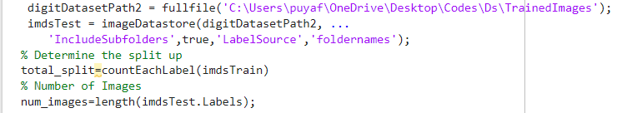
Load the test data using the imageDatastore function. This data will be used to evaluate the trained network.
Define the architecture of the DCNN using a layer graph. The architecture consists of multiple convolutional layers, each followed by a ReLU activation function and a max pooling layer. The final layers are a global average pooling layer, a fully connected layer, a softmax layer, and a classification layer.
Notes:
This code imports another dataset of images from a different directory and creates an imageDatastore object that stores the images and their corresponding labels.

Slide 7
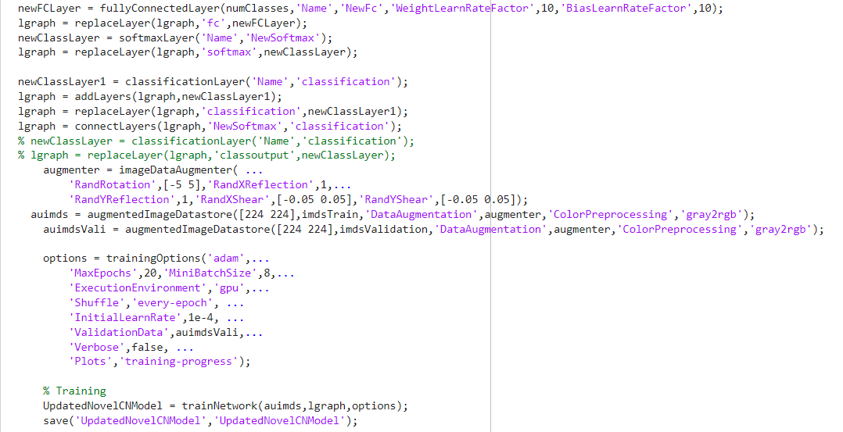
Notes:
This code performs fine-tuning of a pre-trained convolutional neural network (CNN) for a classification task. Here's a breakdown of what the code does:
Load the pre-trained CNN from a MAT-file 'updatedNet.mat' into a variable 'net'.
Create a layer graph 'lgraph' from the loaded CNN using the 'layerGraph' function.
Clear the 'net' variable to free up memory.
Determine the number of classes in the training data by counting the number of unique labels in 'imdsTrain.Labels'.
Add a new fully connected layer with 'numClasses' output neurons to the layer graph, named 'NewFc'.
Replace the original fully connected layer in the layer graph with the newly added one.
Add a new softmax layer to the layer graph, named 'NewSoftmax'.
Replace the original softmax layer in the layer graph with the newly added one.
Add a new classification layer to the layer graph, named 'classification', to specify the output format of the network.
Connect the output of the 'NewSoftmax' layer to the 'classification' layer in the layer graph.
Define an image data augmenter with a variety of augmentations such as rotation, reflection, and shearing.
Create an augmented image datastore 'auimds' from the training data using the augmenter and specifying the desired image size of [224 224].
Create an augmented image datastore 'auimdsVali' from the validation data using the same augmenter and image size.
Define training options such as the optimizer, maximum number of epochs, mini-batch size, execution environment, learning rate, validation data, and verbosity.
Train the updated CNN using the training data 'auimds', the layer graph 'lgraph', and the specified training options.
Save the trained network as a MAT-file 'UpdatedNovelCNModel.mat' in the current directory.

Slide 8
Analysis
The training is performed using the Adam optimizer with a mini-batch size of 8 and a maximum of 20 epochs. The execution is done on a GPU to speed up the training process. Finally, the trained model is saved for future use. The objective of this process is to improve the accuracy of the pre-trained model in recognizing images in a specific domain by fine-tuning it to the new task.
Task 1: Implement DCNN Architecture on the dataset
Task 2: Implement DarkNet-19 Architecture on dataset
Task 3: Implement ResNet-50 Architecture on dataset
Task 4: Implement Efficient B0 Architecture on dataset

Slide 9
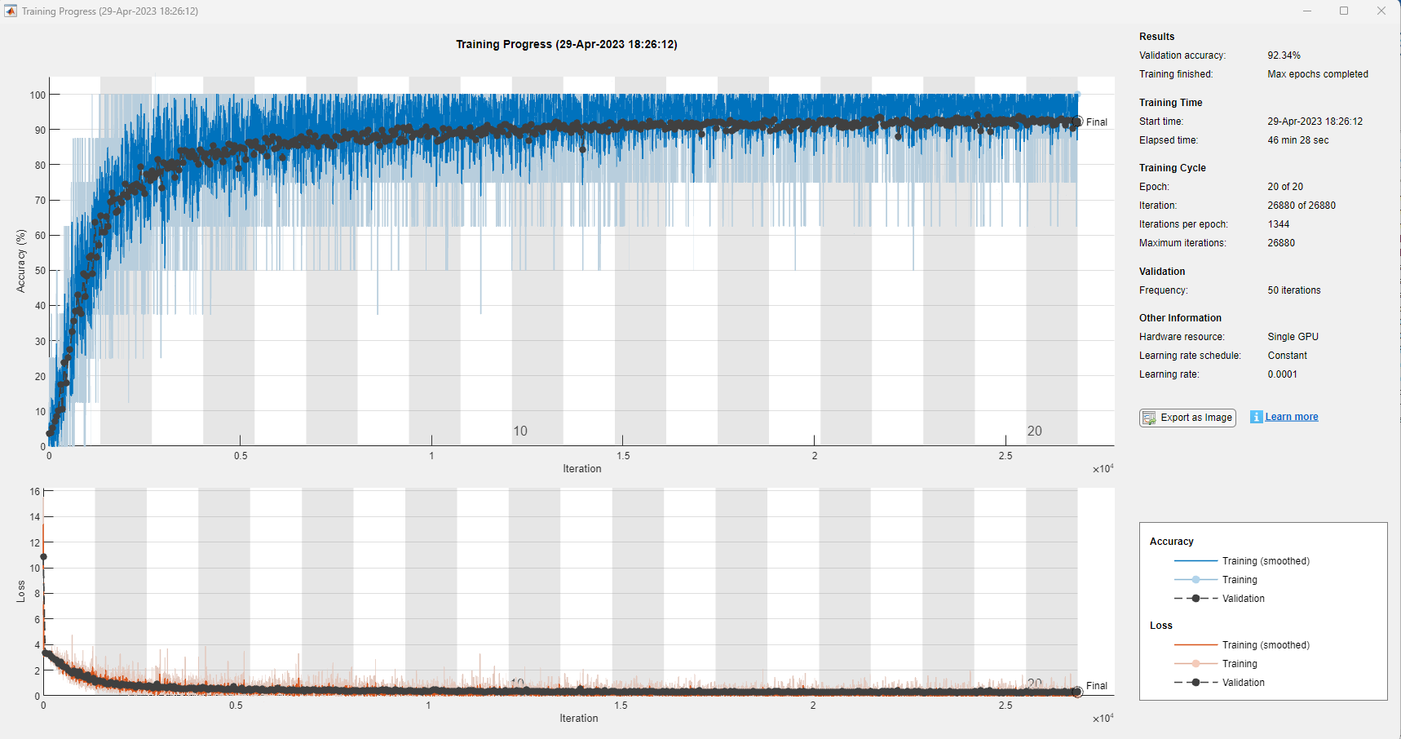
DCNN Architecture Training Results

Slide 10
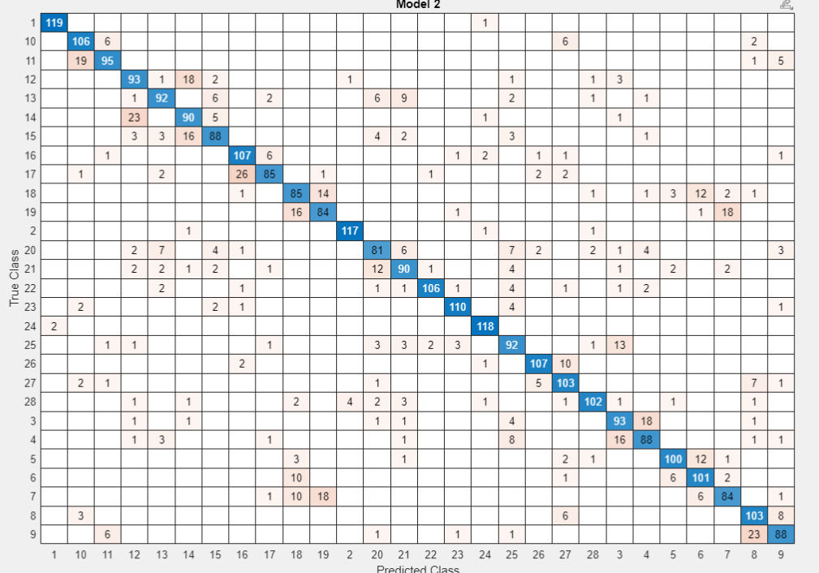
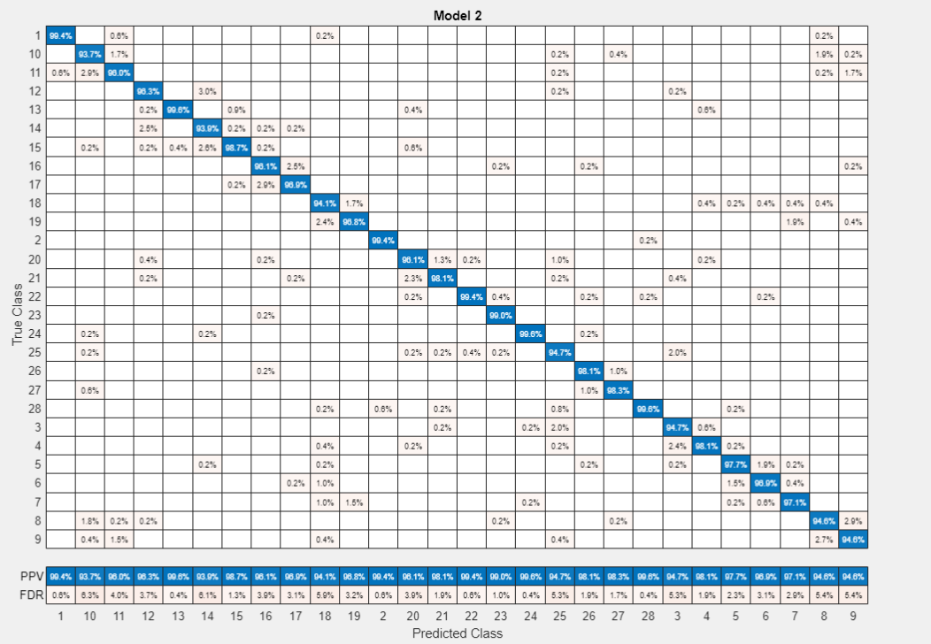
Confusion Matrices
KNN Confusion matrix for DCNN
KNN Confusion matrix with % success rate on each class:

Slide 11
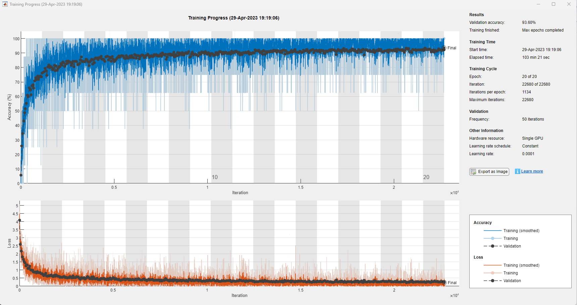
DarkNet19 Architecture Training Results

Slide 12
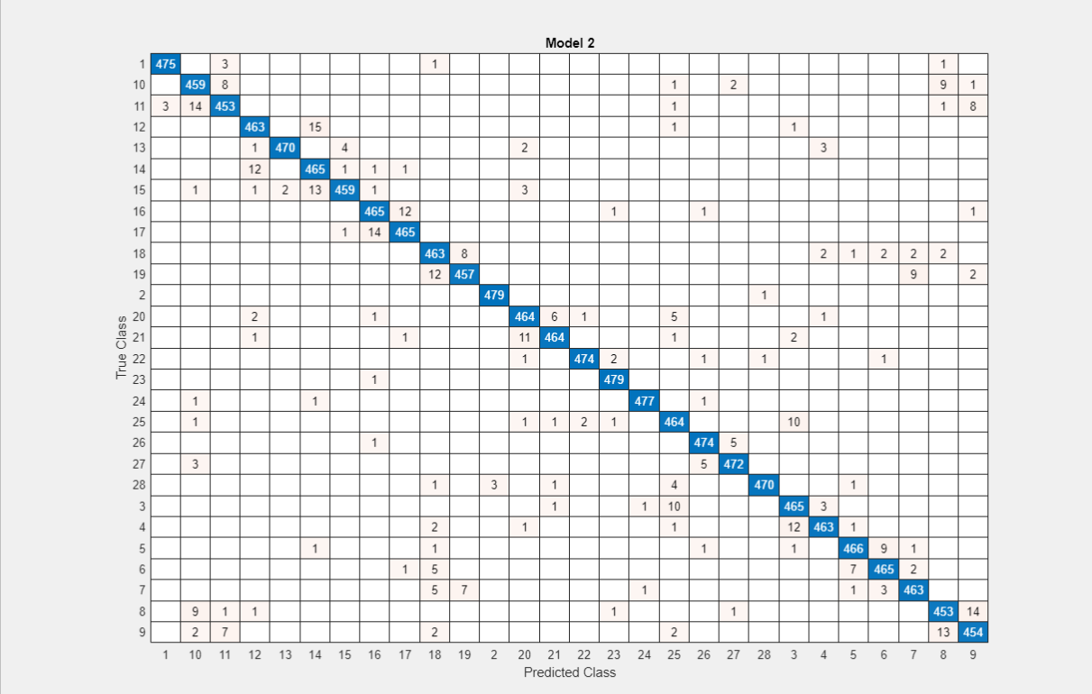
Confusion Matrices
KNN Confusion matrix for DCNN
KNN Confusion matrix with % success rate on each class:

Slide 13
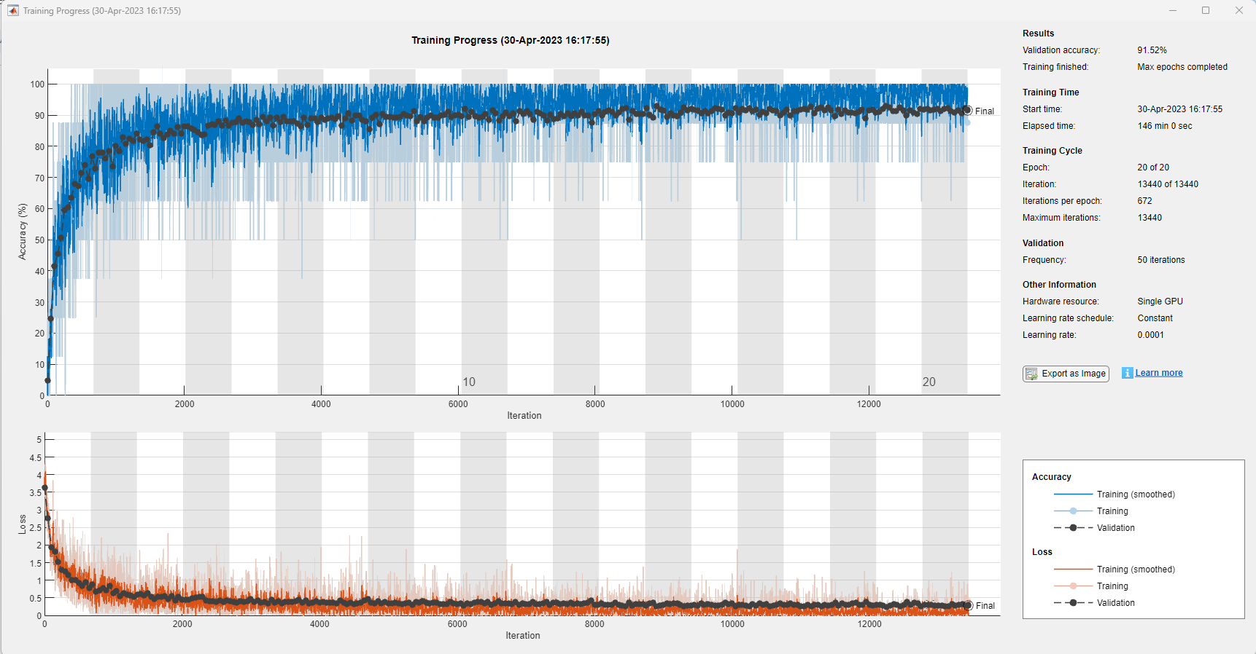
ResNet50 Architecture Training Results

Slide 14
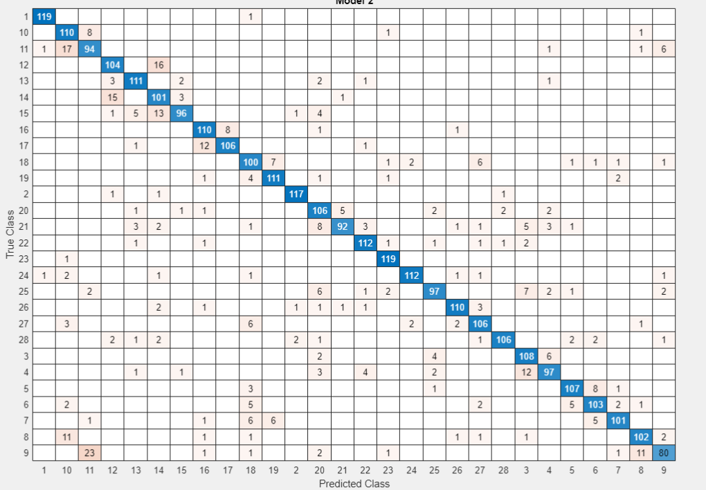
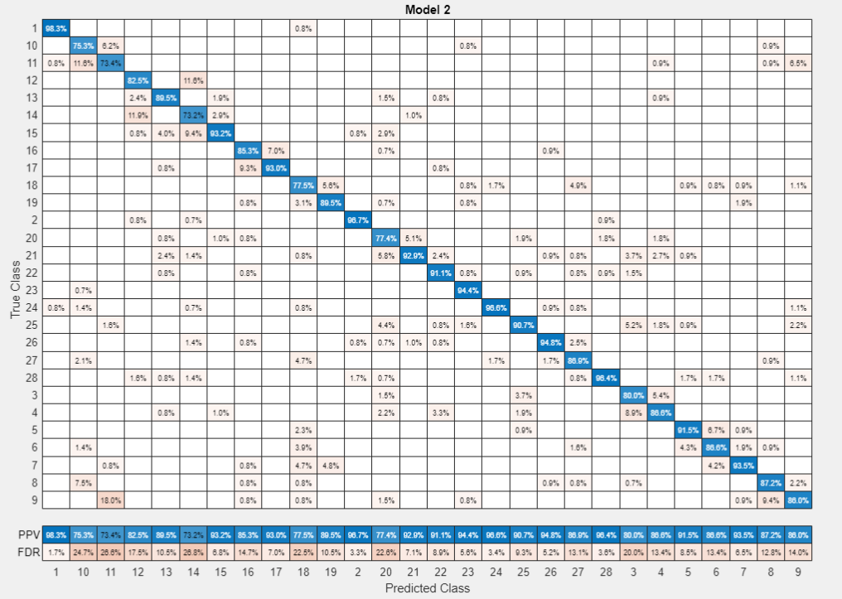
Confusion Matrices
KNN Confusion matrix for DCNN
KNN Confusion matrix with % success rate on each class:

Slide 15
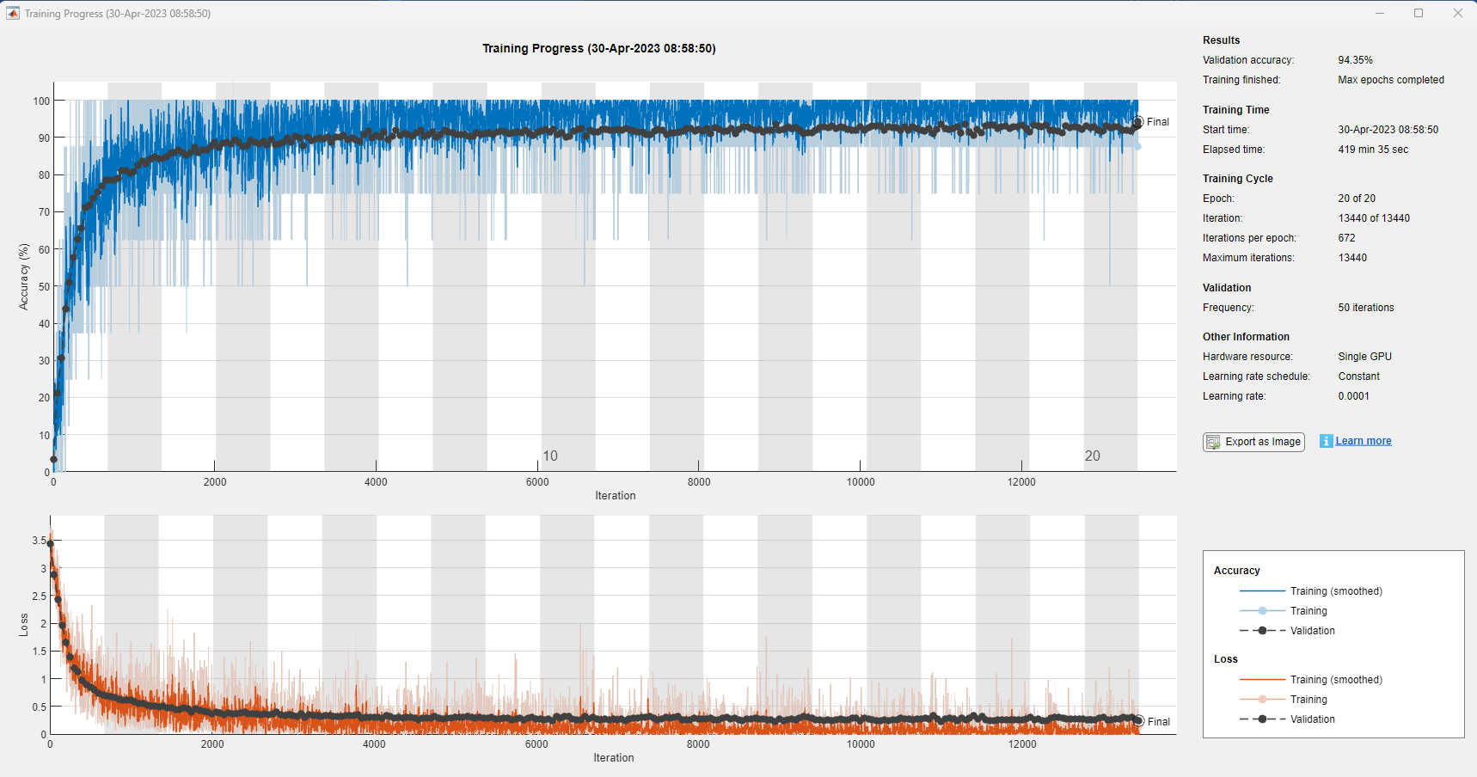
Efficient B0 Architecture Training Results

Slide 16
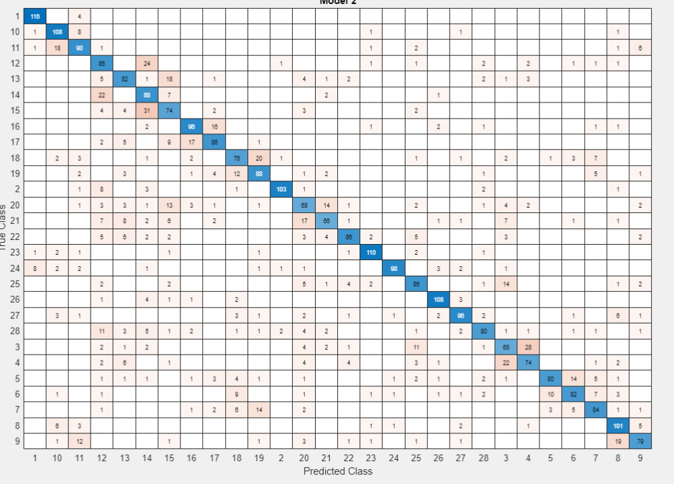
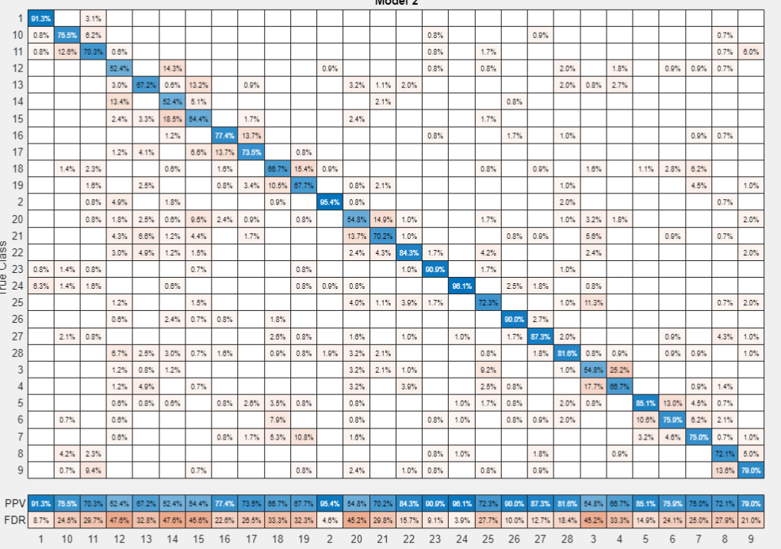
Confusion Matrices
KNN Confusion matrix for DCNN
KNN Confusion matrix with % success rate on each class:

Slide 17
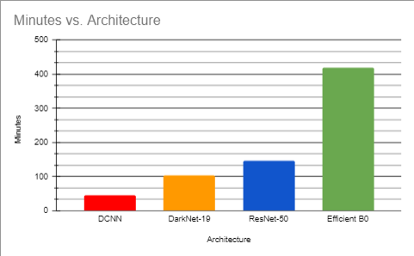
Data Analysis
Graph: time it took to complete the training
As we can observe on the graph above, DCNN architecture that was implemented is performing under the least amount of minutes by 46 mins. On the other hand, Efficient B0 is performing the worst on the same dataset architecture by over 400 minutes.
Darknet19 and Resnet50 are approximately close to each other, between 100-140 minutes for their architecture.
Therefore, we can conclude that the DCNN architecture implemented is the best on the time scaling graph.

Slide 18
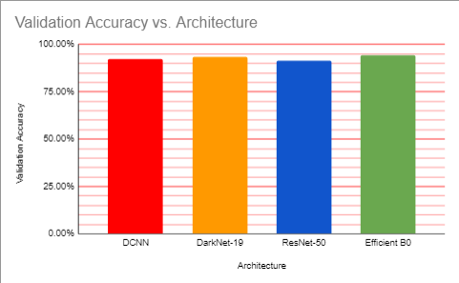

Data Analysis
Graph: Validation Accuracy
Table: Validation Accuracy

Slide 19
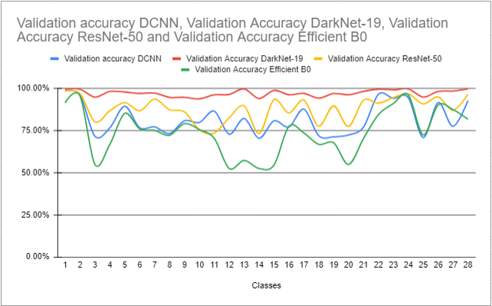
Data Analysis
Findings of architecture versus each class created for the dataset
The dataset consists of Handwritten Arabic characters, and it's important to remember that the alphabet has 28 total characters. Therefore, we first have to put each character into its corresponding class before we train.

Slide 20
Conclusion
As a conclusion, the experiment was successfully conducted across four different data classifier architectures, DCNN, DarkNet-19, ResNet-50, and Efficient B0. The dataset used in this project consisted of more than 3500 training images in 32x32 size, black and white. The dataset has been organized into 28 classes according to their character in the alphabet. The classes one by one went through a training process across all architectures listed in the project. The results of the training process is as follows: Efficient B0 had the highest validation accuracy of 94.35%, following with DarkNet-19 at validation accuracy of 93.60%, then DCNN architecture that was developed by the student that included total of 6 convolution layers, 6 reluLayers, 5 max pooling layers, 1 global Average Pooling Layer, 1 fully Connected Layer , 1 softmax Layer at validation accuracy of 92.34%, and finally ResNet-50 architecture with a 91.52% validation accuracy.
Furthermore, the time complexity of each architecture played an important role in this experiment. The least time taken for the training process was by DCNN architecture, then DarkNet-19, ResNet-50, and Efficient B0 being the worst with a 419 min training time. This concludes that the DCNN architecture designed has the least time consumption for a very good validation accuracy of 92.35%.

Slide 21
References
Lewis, Nick. “Inside the BREACH attack: How to avoid HTTPS traffic exploits.” TechTarget, https://www.techtarget.com/searchsecurity/tip/Inside-the-BREACH-attack-How-to-avoid-HTTPS-traffic-exploits. Accessed 28 April 2023.
“9 Man In the Middle Attack Prevention Methods to Use Now.” Cheap SSL Certificates. Buy SSL/HTTPS Certificate $3.98, 16 November 2021, https://cheapsslsecurity.com/blog/man-in-the-middle-attack-prevention/. Accessed 28 April 2023.
Sen, Kaushik. “What is an Attack Vector? 16 Common Attack Vectors in 2023.” UpGuard, https://www.upguard.com/blog/attack-vector. Accessed 28 April 2023.
“What is MITM (Man in the Middle) Attack | Imperva.” Imperva, Inc., https://www.imperva.com/learn/application-security/man-in-the-middle-attack-mitm/. Accessed 28 April 2023.

